Slide 1
Chapter 6 General Trees
6.1 Definitions and Terminology
6.2 General Tree ADT
6.3 General Tree Implementations
Parent Pointer
Array-based Children List
Linked Children List
Array-based Left-child/Right-sibling
Linked Left-child/Right-sibling
Sequential Implementation
再次复习：18,29,33,36,41,44,49-52

Slide 2
General Trees (1)

Slide 3
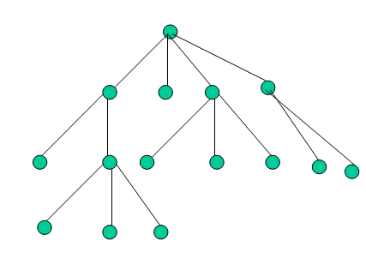
General Trees (2)
A tree T is a finite set of one or more nodes
such that there is one designated node r called
the root of T, and the remaining nodes in
(T –{r}) are partitioned into k≥0 disjoint
subsets T₁, T₂, ..., T_{k}, each of which is a tree,
and whose roots r₁, r₂, ..., r_{k}, respectively, are
children of r.
root
r
r1
r2
r3
r4

Slide 4
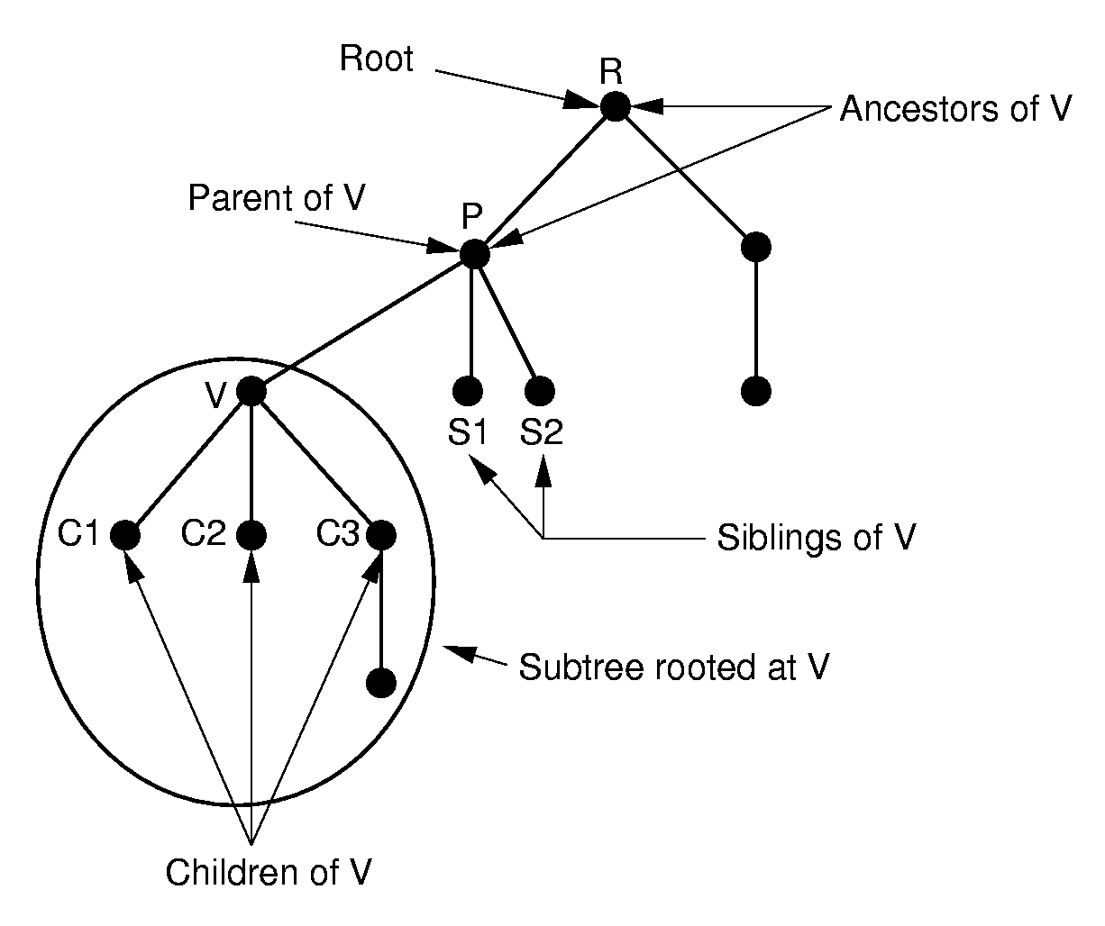
General Trees (3)

Slide 5
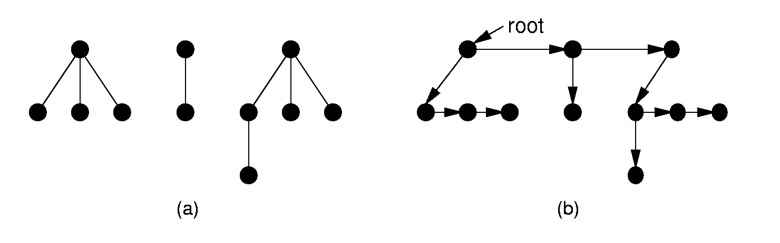
Forest
A forest is a collection of one or more general trees
Notes:
The result is essentially a dynamic implementation for the left child/right sibling representation for general trees.

Slide 6
General Tree Traversal
Preorder traversal
Visit the root
Preorder traversal of all sub-trees from left to right
Postorder traversal
Postorder traversal of all sub-trees from left to right
Visit the root

Slide 7
General Tree Traversal(2)
Preorder traversal:
R
RADEBCFGHK
A
B
C
D
E
F
Postorder traversal:
DEABGHKFCR
G
H
K

Slide 8
Chapter 6 General Trees
6.1 Definitions and Terminology
6.2 General Tree ADT
6.3 Binary Tree Implementations
Parent Pointer
Array-based Children List
Linked Children List
Array-based Left-child/Right-sibling
Linked Left-child/Right-sibling
Sequential Implementation

Slide 9
General Tree Node ADT
// General tree node ADT
template <class Elem> class GTNode {
public:
GTNode(const Elem&); // Constructor
~GTNode(); // Destructor
Elem value(); // Return value
bool isLeaf(); // TRUE if is a leaf
GTNode* parent(); // Return parent
GTNode* leftmost_child(); // First child
GTNode* right_sibling(); // Right sibling
void setValue(Elem&); // Set value
//insert first child
void insert_first(GTNode<Elem>* n);
//insert right sibling
void insert_next(GTNode<Elem>* n);
void remove_first(); // Remove first child
void remove_next(); // Remove sibling
};
Notes:
What API is necessary.

Slide 10
General Tree ADT
// General tree ADT
template <class Elem> class GenTree {
private:
void printhelp(GTNode*); // Print helper function
public:
GenTree(); // Constructor
~GenTree(); // Destructor
void clear(); // Send nodes to free store
GTNode* root(); // Return the root
// Combine two subtrees
void newroot(Elem&, GTNode<Elem>*, GTNode<Elem>*);
void print(); // Print a tree
};

Slide 11
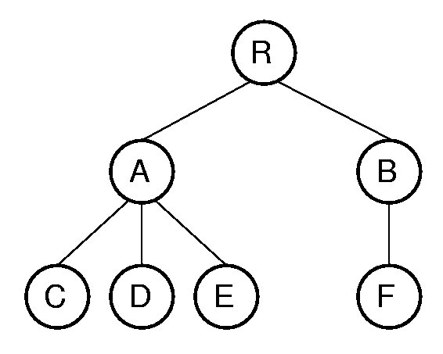
Print by Preorder traversal
template <class Elem>
void GenTree<Elem>::
printhelp(GTNode<Elem>* subroot) {
if (subroot->isLeaf()) cout << "Leaf: ";
else cout << "Internal: ";
cout << subroot->value() << "\n";
for (GTNode<Elem>* temp =
subroot->leftmost_child();
temp != NULL;
temp = temp->right_sibling())
printhelp(temp);
}
Internal: R
Internal: A
Leaf: C
Leaf: D
Leaf: E
Internal: B
Leaf: F
Notes:
Traversal: RACDEBF
Compare with the binary tree.

Slide 12
Chapter 6 General Trees
6.1 Definitions and Terminology
6.2 General Tree ADT
6.3 General Tree Implementations
Parent Pointer
Array-based Children List
Linked Children List
Array-based Left-child/Right-sibling
Linked Left-child/Right-sibling
Sequential Implementation

Slide 13
General Tree Implementation
How to record the relationship between nodes in the tree.
How to implement parent()
How to implement leftmost_child()
How to implement right_sibling()

Slide 14
Chapter 6 General Trees
6.1 Definitions and Terminology
6.2 General Tree ADT
6.3 General Tree Implementations
Parent Pointer
Array-based Children List
Linked Children List
Array-based Left-child/Right-sibling
Linked Left-child/Right-sibling
Sequential Implementation

Slide 15
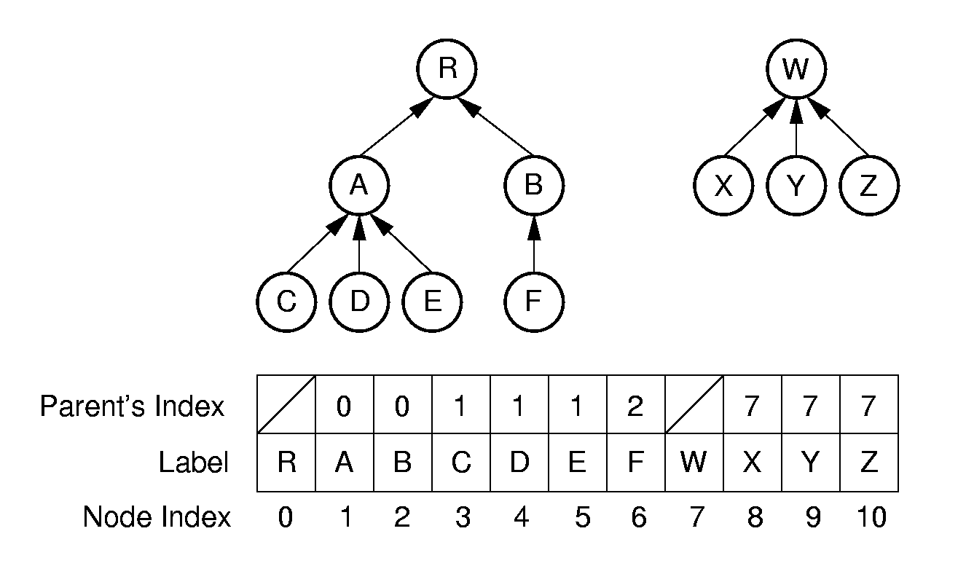
Parent Pointer Implementation(1)
array
present one or more trees in an array

Slide 16
Parent Pointer Implementation(2)
class ParPtrTree
{
private:
int * array;
int size;
public:
Gentree(int);
~Gentree(){delete[] array; }
0
1
2
#define ROOT -1
3
4
5
6
array

Slide 17
Parent Pointer Implementation(3)
public:
int FIND(int) const; // find root of a node
bool differ(int, int); //judge if two nodes are in a same tree
void UNION(int, int); //merge two sub tree
};
Easy to locate parent, hard to locate children
array

Slide 18
Parent Pointer Implementation(4)
// find root of a node
int ParPtrTree ::FIND(int curr) const {
while (array[curr]!=ROOT) curr = array[curr];
return curr; // At root
}
array[root]=ROOT
array
Notes:
Examples of equivalence classes:
Connected components in graphs
Point clustering

Slide 19
Parent Pointer Implementation(5)
// Return TRUE if nodes in different trees
bool ParPtrTree::differ(int a, int b) {
int root1 = FIND(a); // Find root for a
int root2 = FIND(b); // Find root for b
return root1 != root2; // Compare roots
}
array
Notes:
Examples of equivalence classes:
Connected components in graphs
Point clustering

Slide 20
Parent Pointer Implementation(6)
//merge two sub tree
void ParPtrTree ::UNION(int a, int b) {
int root1 = FIND(a); // Find root for a
int root2 = FIND(b); // Find root for b
if (root1 != root2) array[root2] = root1;
}
root1
root2
Union(3,8)
array
0
Notes:
Examples of equivalence classes:
Connected components in graphs
Point clustering

Slide 21
Application
The parent pointer representation is often used to maintain a collection of disjoint sets:
To determine if two objects are in the same set.
differ(int, int)
To merge two sets together
UNION(int, int)

Slide 22
Improve performance (1)
The efficiency of find(), differ () , UNION() in average case depends on the average depth of the nodes in the tree.

Slide 23
Improve performance (2)
Methods to reduce the average depth:
Weighted union rule
Path Compression

Slide 24
Weighted union rule (1)
Weighted union rule: Join the tree with fewer nodes to the tree with more nodes to keep the height of tree small.
1
3
3
+
=
Average depth =
(0+1+1+1+2)/5=1
2
4
5
1
5
4
2

Slide 25
Weighted union rule (2)
Weighted union rule: Join the tree with fewer nodes to the tree with more nodes to keep the height of tree small.
1
3
1
+
=
Average depth =
(0+1+1+2+2)/5=6/5
2
4
5
2
3
4
5

Slide 26
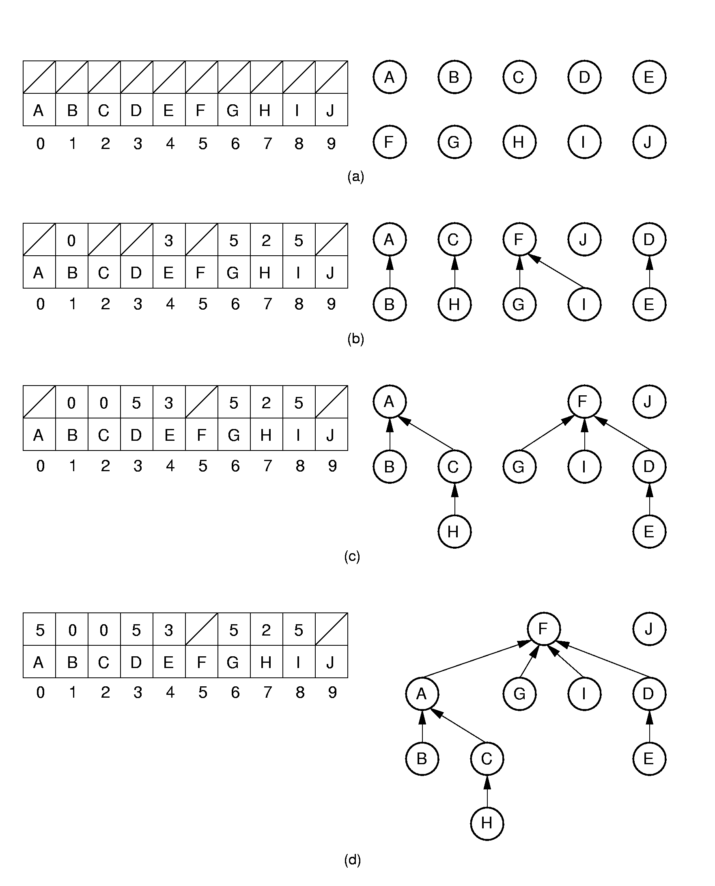
Weighted union rule (3)
Union (A,B) (C,H) (G,F) (D,E) (I,F) (H,A) (E,G)

Slide 27
Weighted union rule(4)
Union(H,E)
Notes:
(d) shows the result of processing equivalence (H, E).

Slide 28
Path Compression
Reduce the average depth of nodes by path compression:
The path compression happens when Find(x) is called: let the nodes in the path to x directly connect to the root.
0
0
1
3
1
Find (5)
5
3
2
4
2
4
5
Notes:
Path compression is used to process equivalence (H, E).

Slide 29
Path Compression (2)
int Gentree::FIND(int curr) const {
if (array[curr] == ROOT) return curr;
return FIND(array[curr]);
}
array[curr] =
0
FIND(5)=FIND(3)=FIND(1)=FIND(0)=0
0
array[5]=FIND(3)
1
Find (5)
array[3]=FIND(1)
1
3
2
3
array(1) = FIND(0)
curr
5
2
4
4
5
array[1]=0
0
1
1
3
3
0
1
0
3
0
array[3]=0
0 1 2 3 4 5
0 1 2 3 4 5
array[5]=0
Notes:
Path compression is used to process equivalence (H, E).

Slide 30
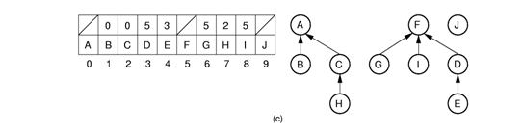
Put together
root1 = FIND(H);
root2 = FIND(E);
array[?] = ?;
Path Compression
Weighted union rule
Union(H,E)
root2
J
root1
F
A
G
I
D
E
B
C
H
Notes:
Path compression is used to process equivalence (H, E).

Slide 31
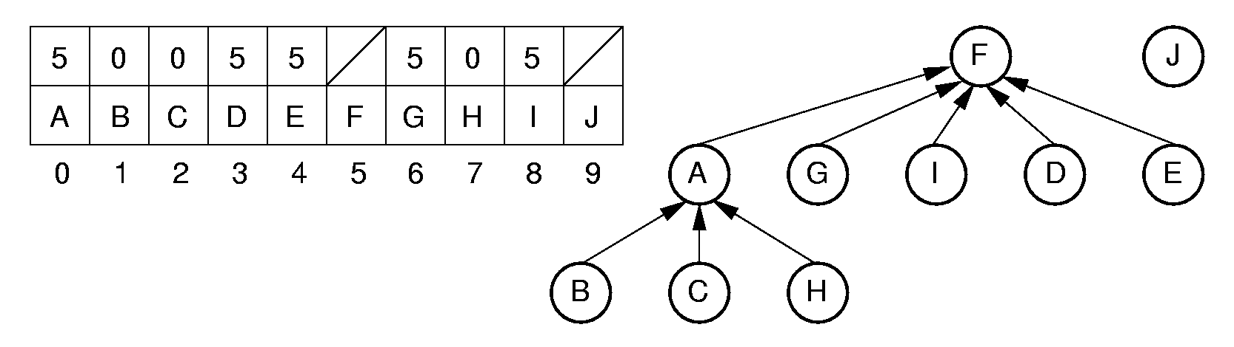
Put together
root2
J
root1
F
A
G
I
D
E
B
C
H
root1 = FIND(H);
root2 = FIND(E);
array[?] = ?;
Path Compression
Weighted union rule
Union(H,E)
array[root1] = root2;
Notes:
Path compression is used to process equivalence (H, E).

Slide 32
Chapter 6 General Trees
6.1 Definitions and Terminology
6.2 General Tree ADT
6.3 General Tree Implementations
Parent Pointer
Array-based Children List
Linked Children List
Array-based Left-child/Right-sibling
Linked Left-child/Right-sibling
Sequential Implementation

Slide 33
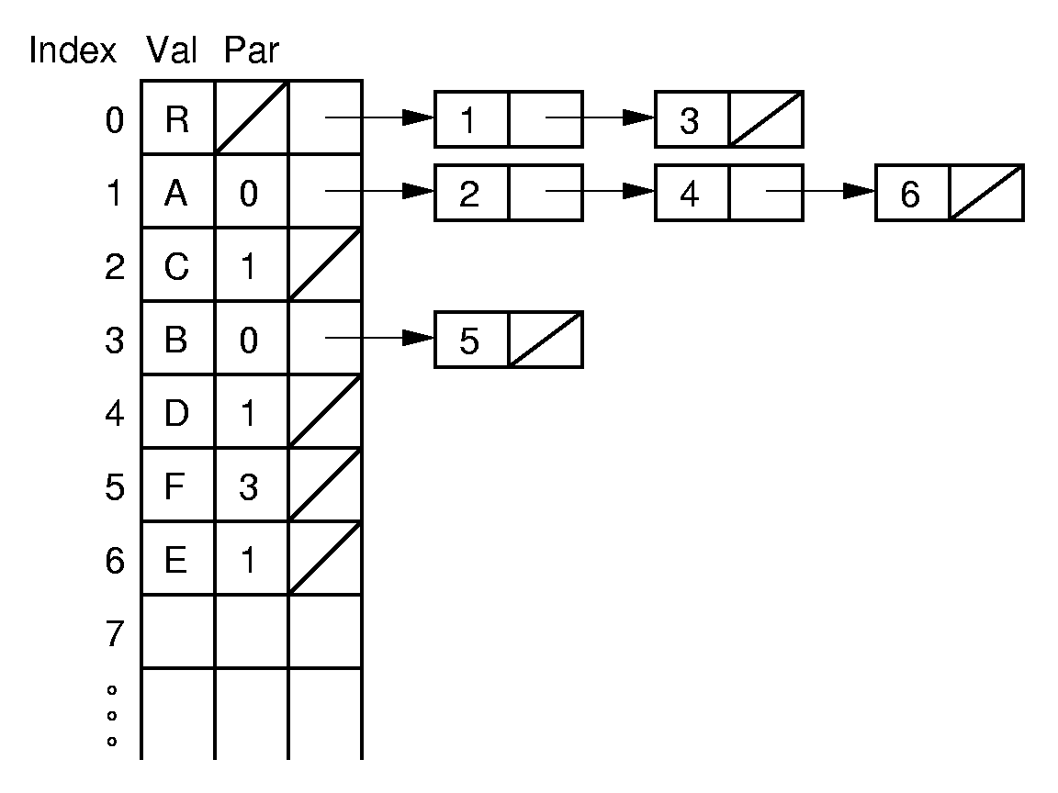
Array-based Children List
Easy to locate parent and children, but not right sibling
Notes:
The next several slides show various possible implementations for general trees.
A key gauge for the quality of these representations is how well they perform the key tasks of left-child, right-sibling, and parent. This representation is poor for finding the right sibling of a node.

Slide 34
Chapter 6 General Trees
6.1 Definitions and Terminology
6.2 General Tree ADT
6.3 General Tree Implementations
Parent Pointer
Array-based Children List
Linked Children List
Array-based Left-child/Right-sibling
Linked Left-child/Right-sibling
Sequential Implementation

Slide 35
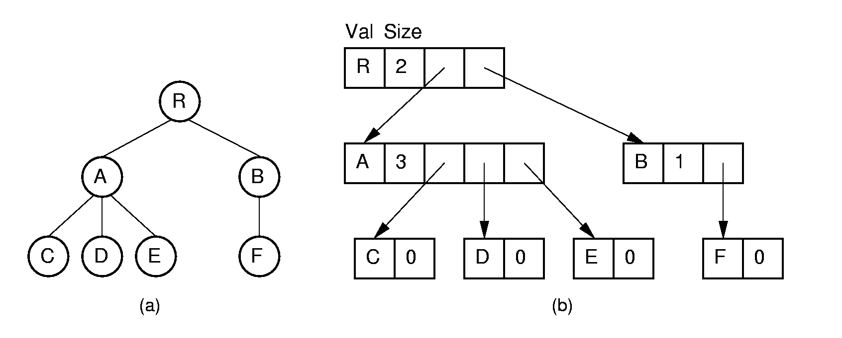
Linked Children list (1)
Dynamic node implementations
Notes:
Essentially an array-based list of children.

Slide 36
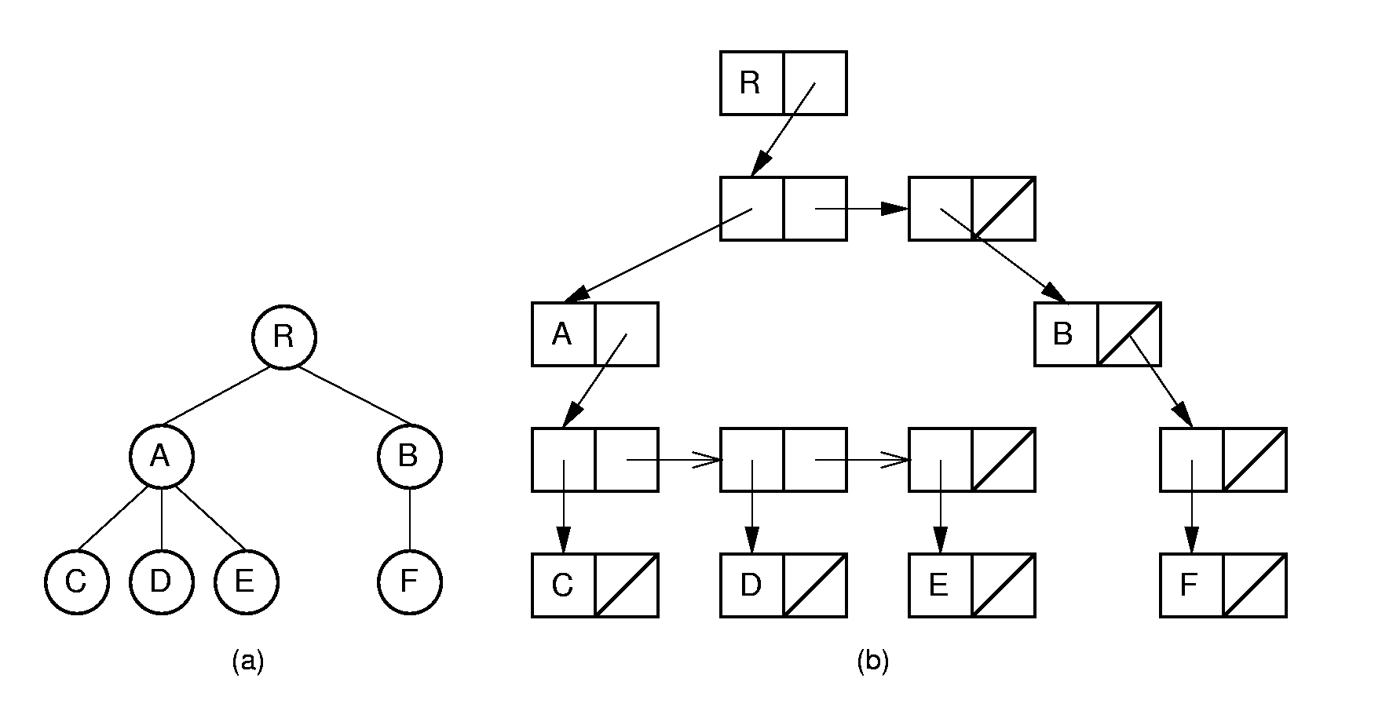
Linked Children list (2)
struct Node_E {
Elem e;
Node_P* children;
};
struct Node_P {
Node_E* node;
Node_P* next;
};
Notes:
Essentially a linked list of children.

Slide 37
Chapter 6 General Trees
6.1 Definitions and Terminology
6.2 General Tree ADT
6.3 General Tree Implementations
Parent Pointer
Array-based Children List
Linked Children List
Array-based Left-child/Right-sibling
Linked Left-child/Right-sibling
Sequential Implementation

Slide 38
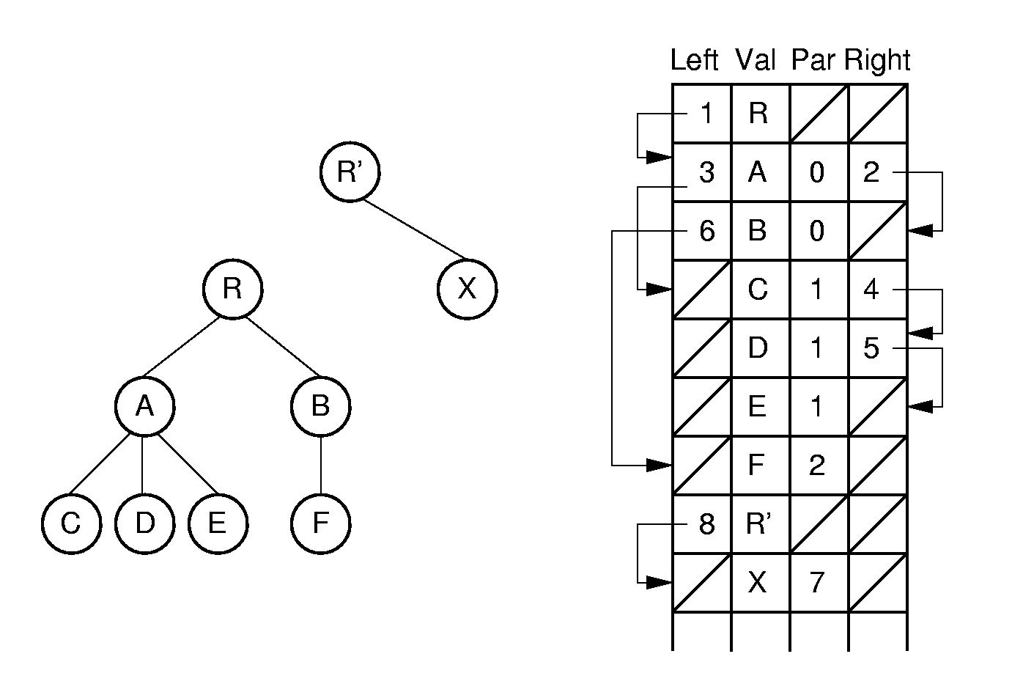
Array-based Left-child/Right-sibling(1)
0
1
2
3
4
5
6
7
8
Easy for Parent(), leftmost_child() and right_sibling()
Notes:
Note: Two trees share the same array.

Slide 39
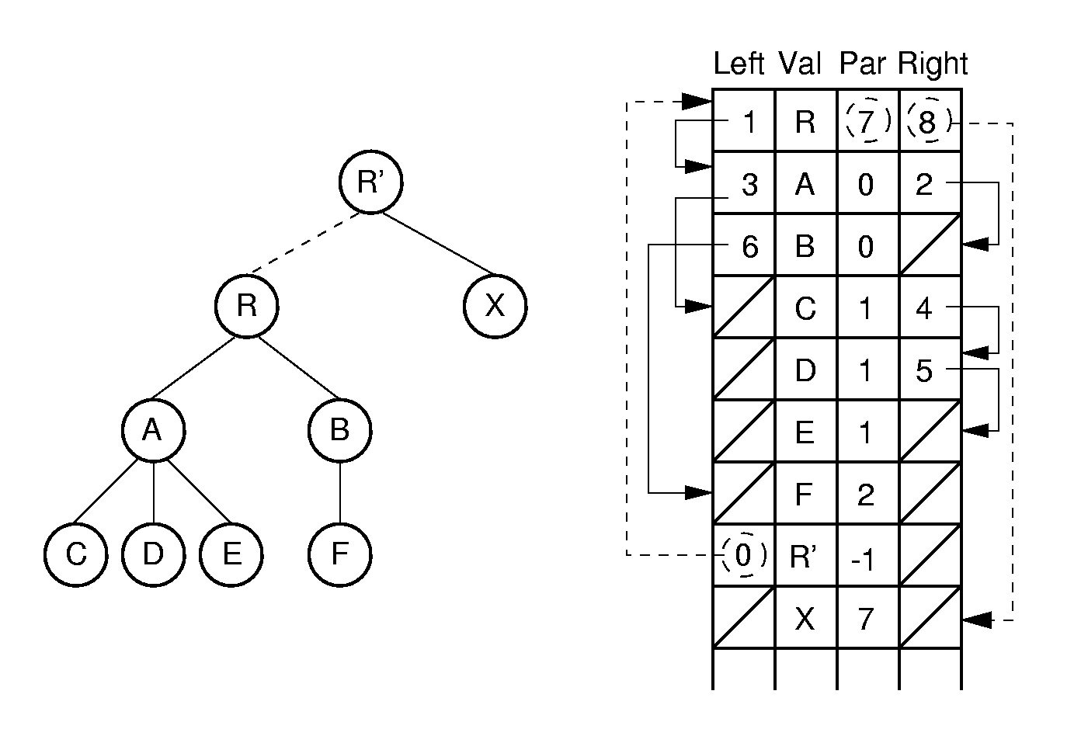
Array-based Left-child/Right-sibling(2)
0
1
2
3
4
5
6
7
8
Notes:
Here, the two trees are joined together. Few links need to be adjusted in the implementation to support this join action.

Slide 40
Chapter 6 General Trees
6.1 Definitions and Terminology
6.2 General Tree ADT
6.3 General Tree Implementations
Parent Pointer
Array-based Children List
Linked Children List
Array-based Left-child/Right-sibling
Linked Left-child/Right-sibling
Sequential Implementation

Slide 41
Linked Left-child/Right-sibling
R
A
R
D
B
A
B
C
E
C
F
D
E
F
G
G
H
K
H
K
A General tree can be represented as a binary tree in this way

Slide 42
Converting to a Binary Tree(1)
R
R
A
A
B
C
D
B
D
E
F
E
C
G
H
K
F
G
H
Left-child/Right-sibling
K

Slide 43
Converting to a Binary Tree(2)
A forest can also be converted to binary tree
Notes:
The result is essentially a dynamic implementation for the left child/right sibling representation for general trees.

Slide 44
Converting to a Binary Tree(3)
A
E
G
A
森林与二叉树对应
B C D
F
H I
B E
J
C
F
G
树与二叉树对应
A
G
D
H
E
B
H
I
F
树根相连
C
I
J
D
J

Slide 45
K-ary Tree
K-ary trees are trees whose internal nodes all have exactly K children.
In general, K-ary trees bear many similarities to binary trees, and similar implementations can be used for K-ary tree nodes.
Full binary tree is 2-ary Tree.
Quadtree & Octree
2D&3D graphics, computer game, spacial modeling, conllision detection,......

Slide 46
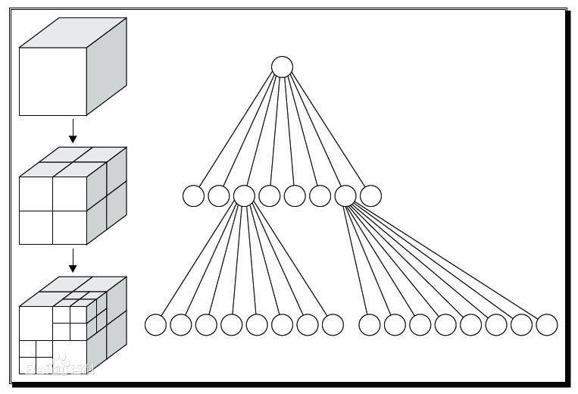
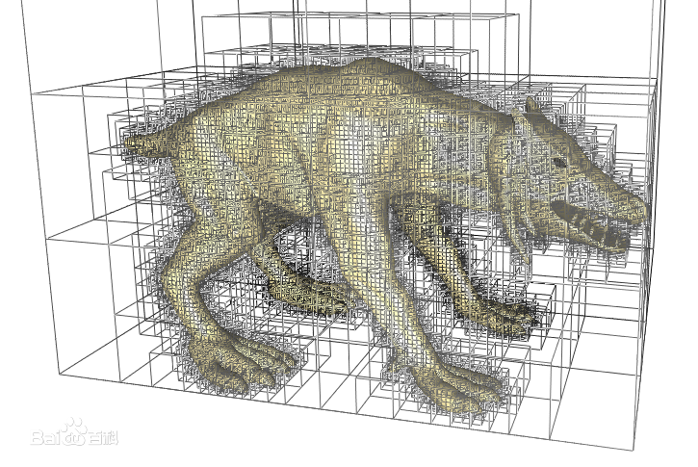
Octree

Slide 47
Chapter 6 General Trees
6.1 Definitions and Terminology
6.2 General Tree ADT
6.3 General Tree Implementations
Parent Pointer
Array-based Children List
Linked Children List
Array-based Left-child/Right-sibling
Linked Left-child/Right-sibling
Sequential Implementation

Slide 48
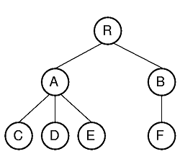
Sequential Implementations (1)
How to store a series of node values with the minimum information needed to reconstruct the tree structure?
Useful to archiving trees on disk.
Notes:
This example refers to the tree of Figure 6.16.

Slide 49
Sequential Implementations (2)
Example1:
ABDCEGFHI
For binary trees, us a symbol to mark null links.
AB/D//CEG///FH//I//
How many characters in total?
preorder traversal

Slide 50
Sequential Implementations (3)
Example2:
mark nodes as leaf or internal.
A’B’/DC’E’G/F’HI
preorder traversal

Slide 51

Sequential Implementations (4)
Example 3: For general trees, mark the end of each subtree.
RAC)D)E))BF)))
1. Print root
2. For each subtree of root do
Print the subtree
5. End for
6. Print ‘)’
preorder traversal
Notes:
The first example includes two “/” marks because the example tree is not full. Cost is one additional bit per node.
The second example refers to the general tree of Figure 6.3.

Slide 52
Exercises
P213 6.15
Given a tree, how to write program to output the sequential string like “RAC)D)E))BF)))”?
void PrintTree(GTNode* root);
Given a sequential string like “RAC)D)E))BF)))”, how to build a tree?
bool BuildTree (char* str,
int len, GTNode*& root) ;

